Slide 1

Advanced SQL – Reinforcement Project
IMDB Dataset
By:
Anbunagalakshmi
DADS
Feb-2025
Online Batch

Slide 2
About the IMDb Dataset 📊
Title: Introduction to IMDb Dataset
Content Summary: =>The dataset includes details on movies, ratings,
genres, and names. =>Designed for reinforcement of SQL querying and
analysis skills.
Tools Used: SQL, IMDb simplified schema

Slide 3
Database Structure Overview
Title: Database Tables & Relationships
Content Summary: The schema contains interconnected tables for movies,
people, and ratings. Foreign keys define the relationships across various
entities.
Explored relationships between tables (e.g., foreign keys, joins)
Tools Used: SQL ERD concepts, Joins

Slide 4
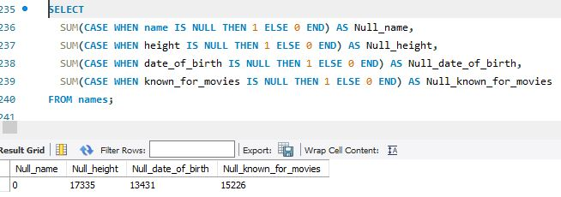
Data Quality Checks⚠️
Title: Null Value Identification
Content Summary: Identified missing or null entries in key datacolumns. Crucial for ensuring accurate results from SQL queries.
Found nulls in 'movie' and 'names' tables and
documented them
Query Performed: IS NULL, COUNT() queries

Slide 5
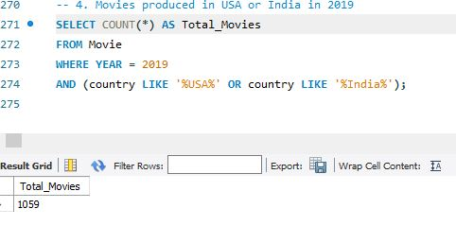
Movie Production Trends 📈
Title: Movie Production Over Time
Content Summary: Analyzed yearly and monthly movie release patterns. Found that 2019 was a peak year with high output
from the USA and India.
Identified production spikes and regional contributions
Query Performed:GROUP BY, YEAR(), MONTH() functions

Slide 6
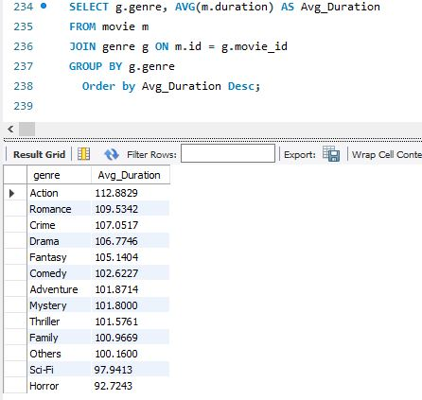
Genre Analysis 🎭
Title: Genre Insights
Content Summary: Examined the distribution and popularity of genres
across movies. Calculated duration trends and frequency of genre combinations.
Query Performed:GROUP BY, HAVING, AVG()

Slide 7
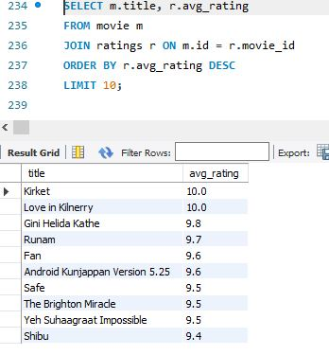
Ratings Overview⭐⭐⭐
Title: Ratings Analysis
Content Summary: Explored top-rated movies and overall rating distribution. Included analysis on average ratings, median groups,
and vote counts.
Identified high-rated and most-voted movies
Query Performed:AVG(), MEDIAN, ORDER BY, LIMIT

Slide 8
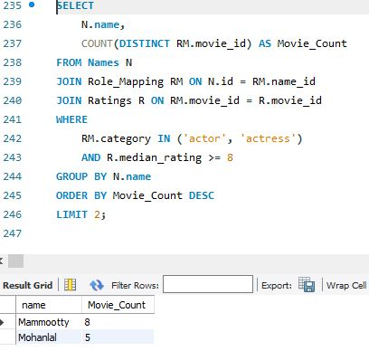
👤 People-Centric Insights
Title: Actors, Directors, & Companies
Content Summary: Analyzed contributions of actors, directors, and companies to IMDb data. Ranked individuals and entities by movie count and performance.
Identified key contributors based on ratings and number of movies
Tools Used: Subqueries, GROUP BY, HAVING COUNT(*) > 3

Slide 9
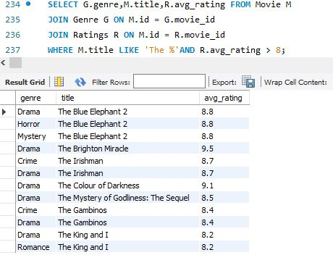
🔍 Patterns & Records
Title: Unique Patterns & Special Records
Content Summary: Investigated unique trends such as movie titles with "The" and long runtimes. Highlighted the oldest and longest movies in the dataset.
Found special case records and title-based patterns
Tools Used: LIKE 'The%', ORDER BY duration DESC, date filters

Slide 10
💡 Conclusion & Key Takeaways
Title: Final Insights & Learnings
Content Summary: The project reinforced SQL proficiency through real-world data analysis. Uncovered actionable insights from structured queries and exploration.
Derived 25+ insights, enhanced query writing, and critical thinking
Tools Used: Advanced SQL (Joins, Aggregations, Filters, Subqueries)

Slide 11


